Slide 1
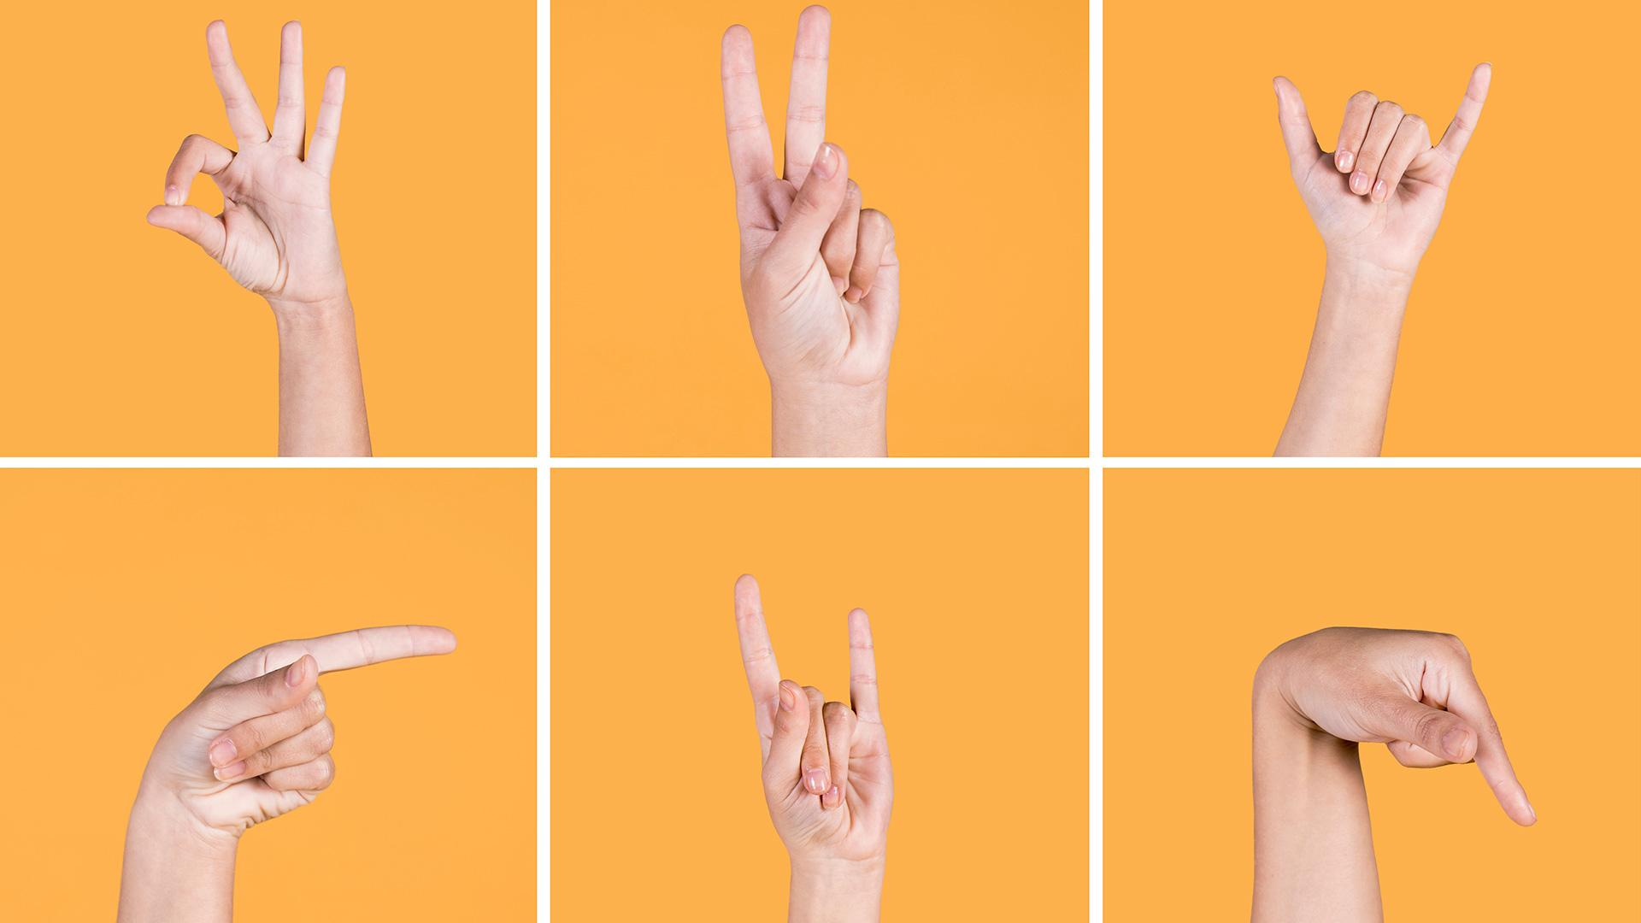
SIGN LANGUAGE TO TEXT CONVERSION
Analysis and Final Flow of the Project
Project Guide : - Ms. Dipali Jethiya
Palak Parikh (IU2141231213)
Pranav Sondagar (IU2141230280)

Slide 2
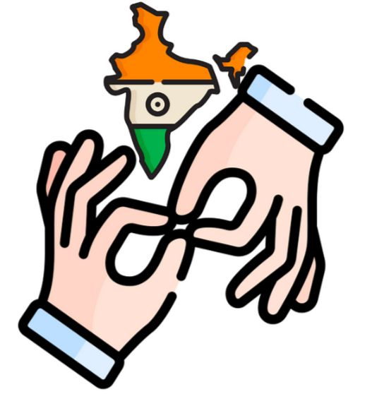
Contents
Introduction
Data Collection
Data Preparation
Model Selection
Training
Testing
Adding new feature (Game)

Slide 3
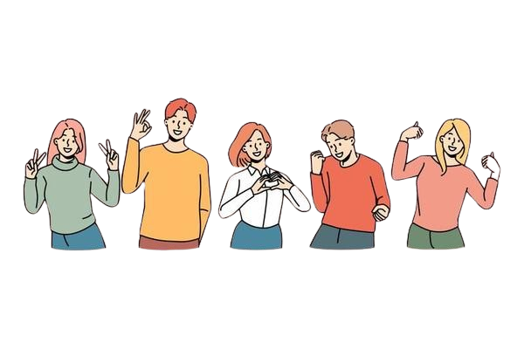
Introduction
This project aims to develop a system that converts sign language into text in real-time.
Provide a user-friendly interface for ease of use.
To make code simple and easy understandable.
TO Add some unique feature to project if possible

Slide 4
Workflow Diagram
Data collection
Data Preparation
Model Selection
Final Touching Or Add New Feature
Testing
Model Training

Slide 5
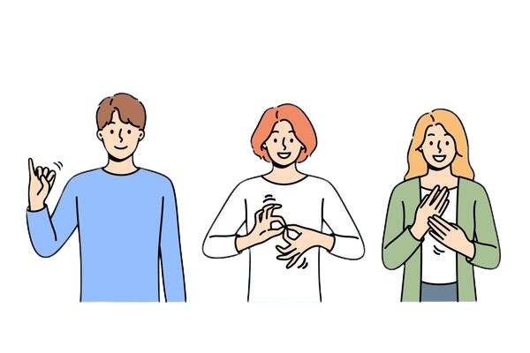
Data collection
We are taking alphabets (A-Z) and number (0-9) as data.
For data collection we will take 1000 per letter to make your model more accurate.
CODE:
This code is a Python script that captures images from a webcam and saves them into specified folders. It allows the user to start and stop the image collection process using keyboard commands, capturing up to 1000 frames per folder

Slide 6
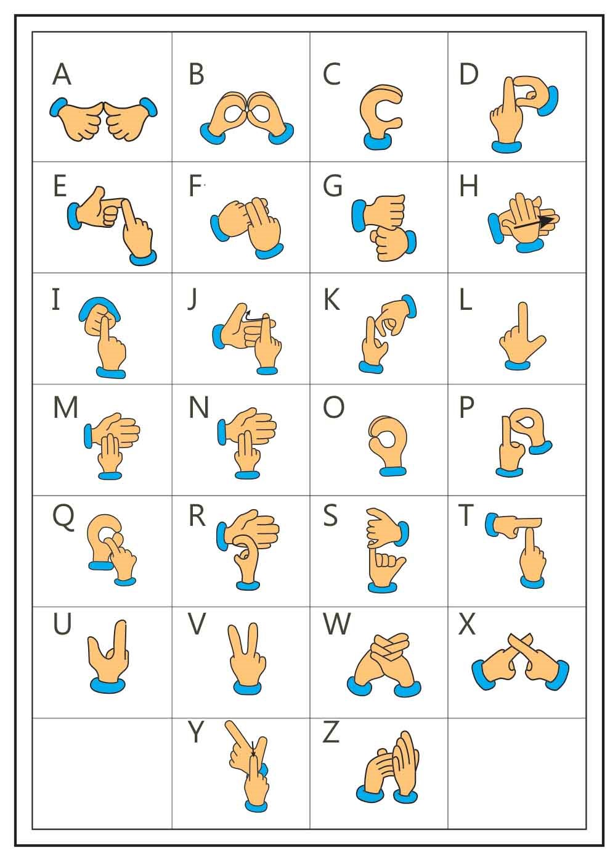
Data Preparation
To check data randomly.
To reduce the size and Quality.
To convert RGB image(colour) to BW image(black white).
To detect hand in every image using Hand detection library.

Slide 7
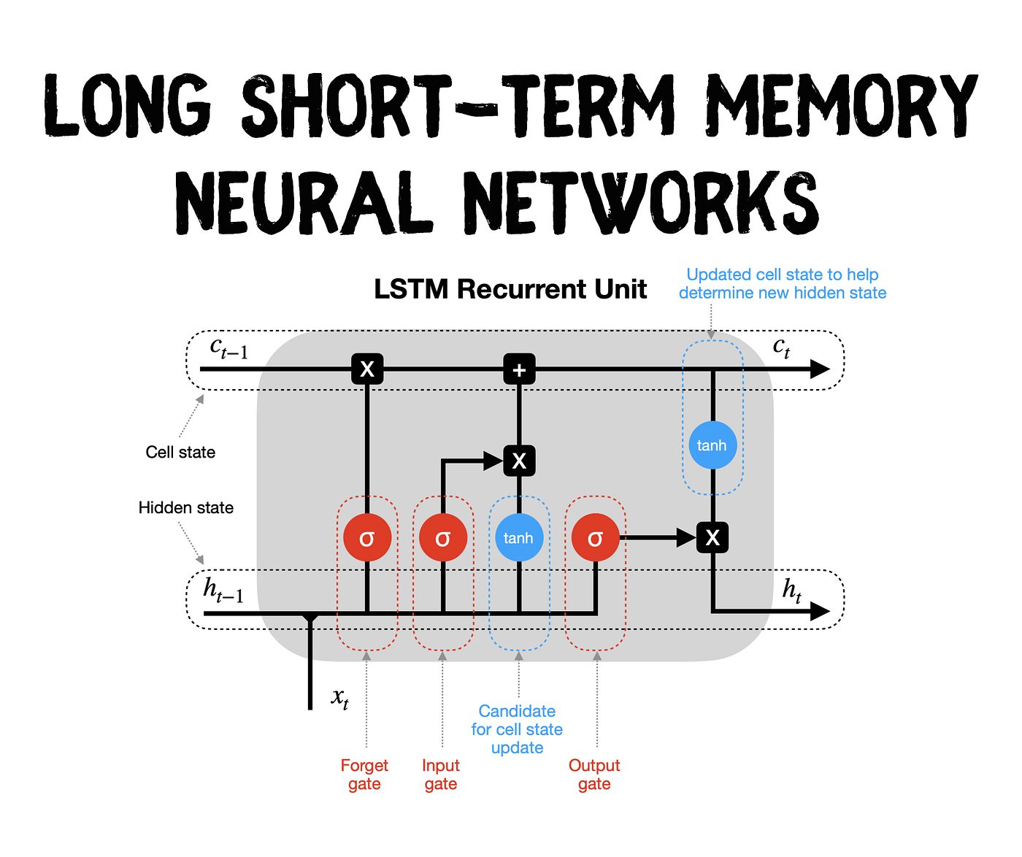
Model Selection
Long Short-Term Memory (LSTM)
LSTMs use cell state and gates to process sequential data.
LSTMs maintain performance over long sequences for speech recognition and translation.
LSTMs are used in NLP, forecasting, sentiment analysis, and video analysis.
Commonly used in sequential data tasks such as language modeling, speech recognition, and time series prediction.

Slide 8

Testing
To check accuracy of output.
To check timing of output.
To check GUI functionality.
To Test the camera in every environment (light and dark area).

Slide 9

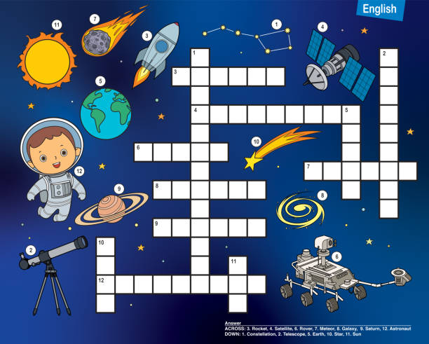
ADD new feature of Game (if possible)

Slide 10


